Slide 1
Making salt dough volcanoes.

Slide 2
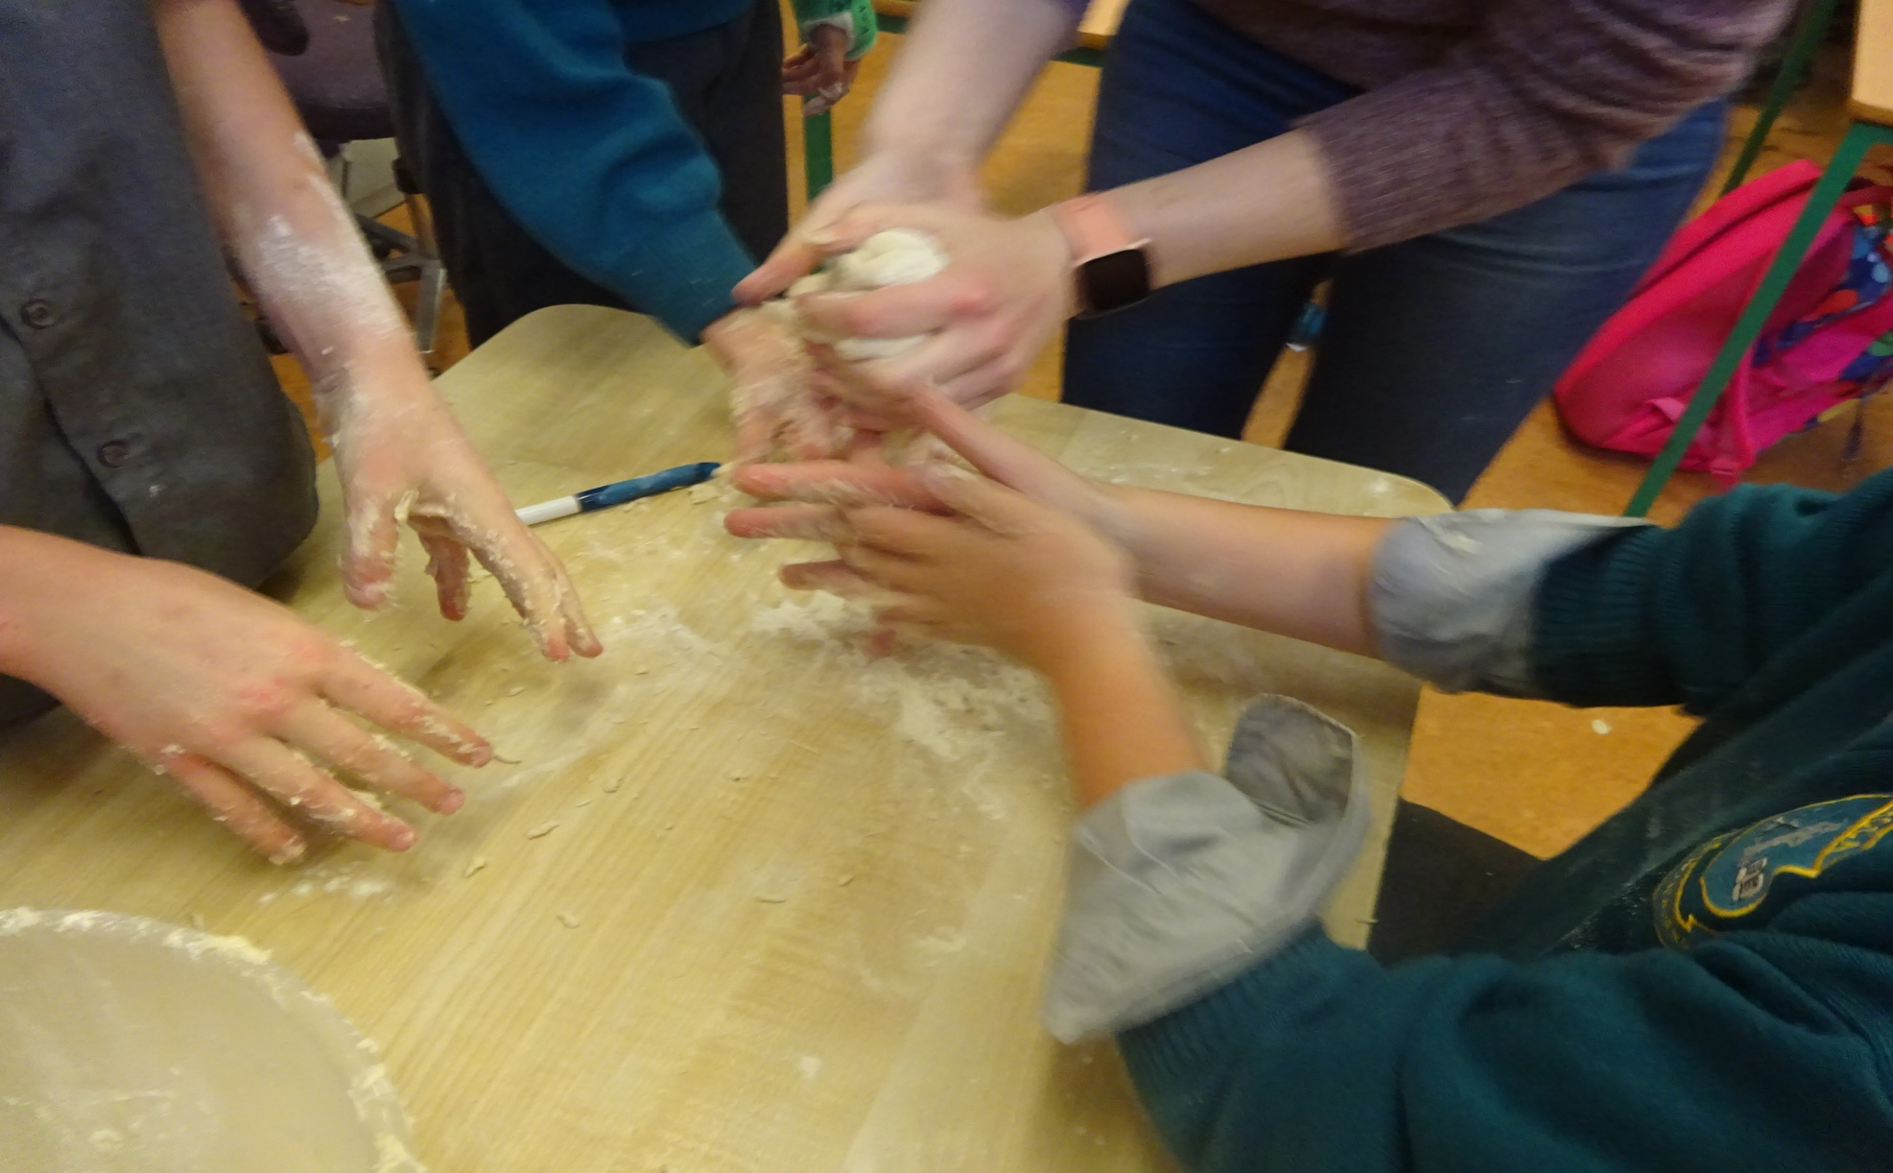
Many hands make light work!

Slide 3
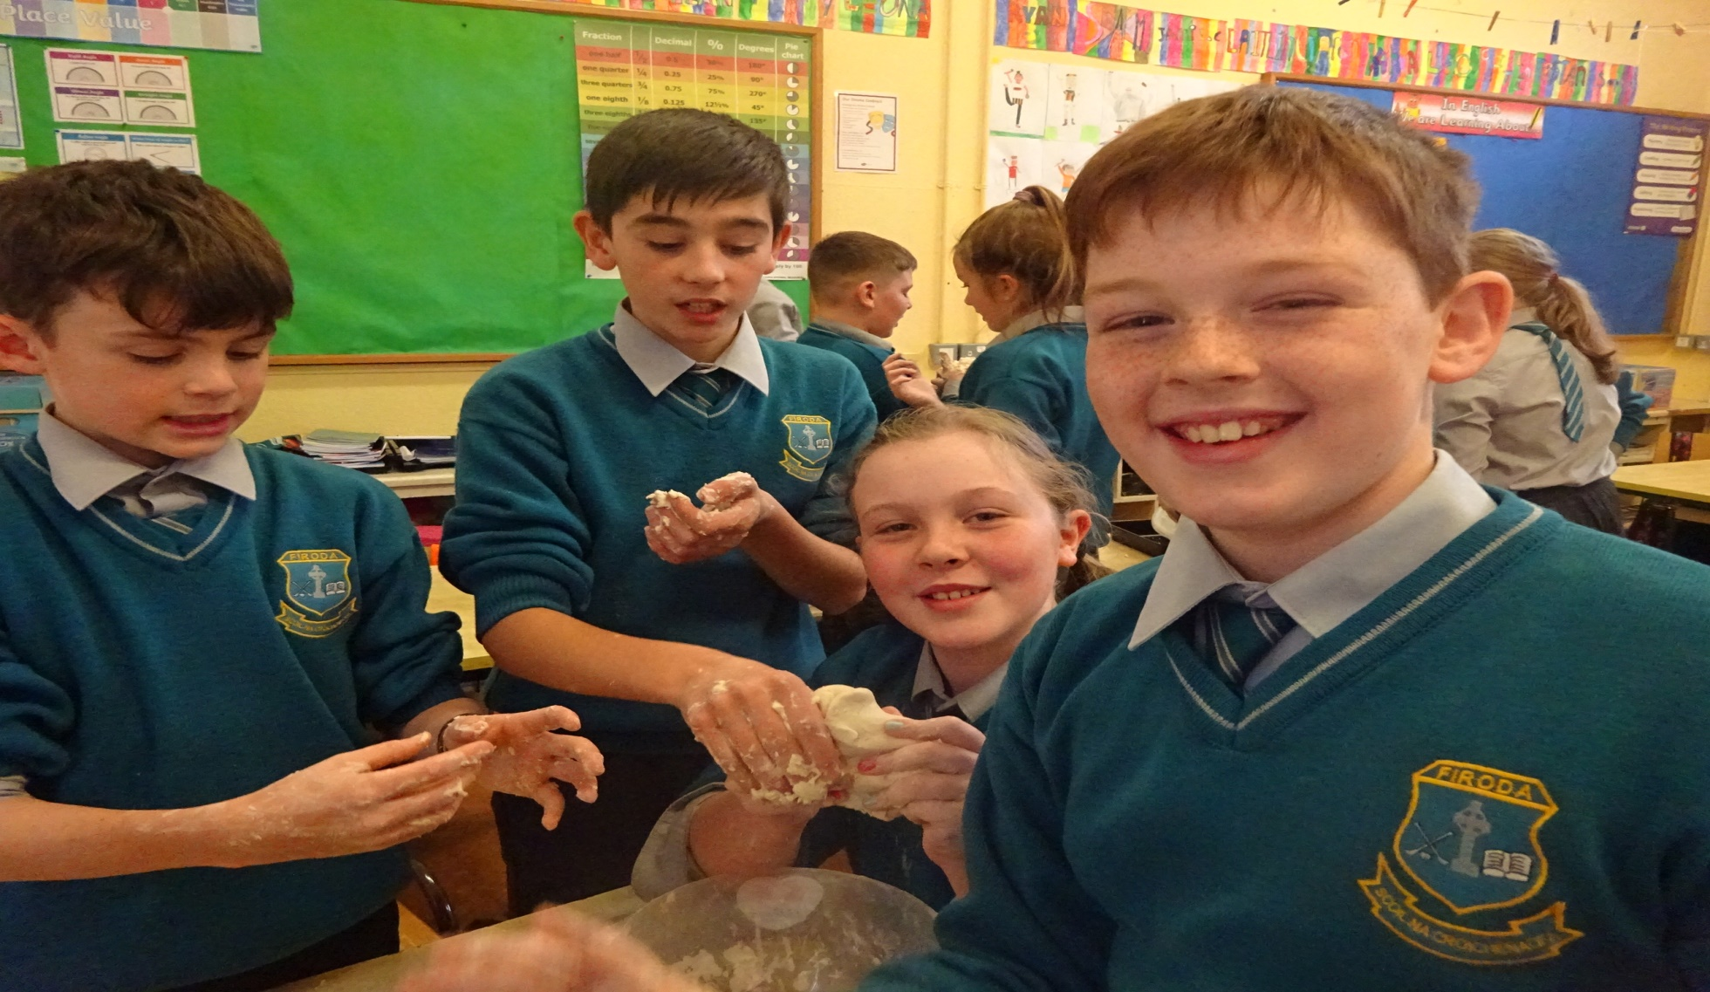
Happiest when making a mess!

Slide 4
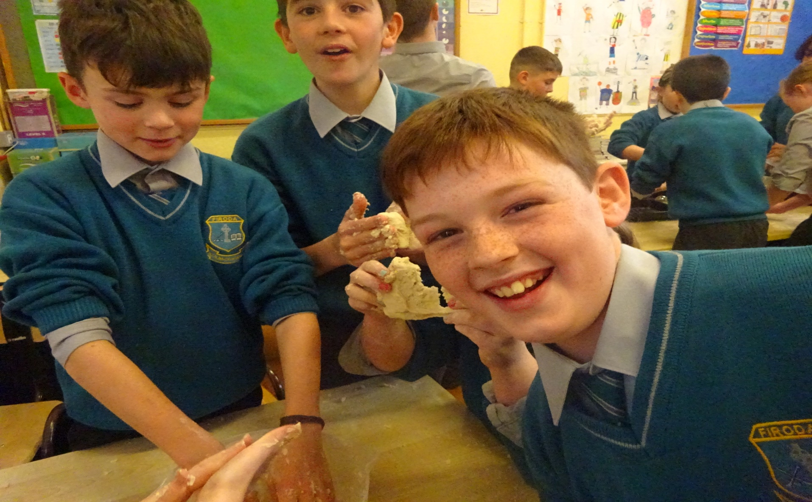
Take 2

Slide 5
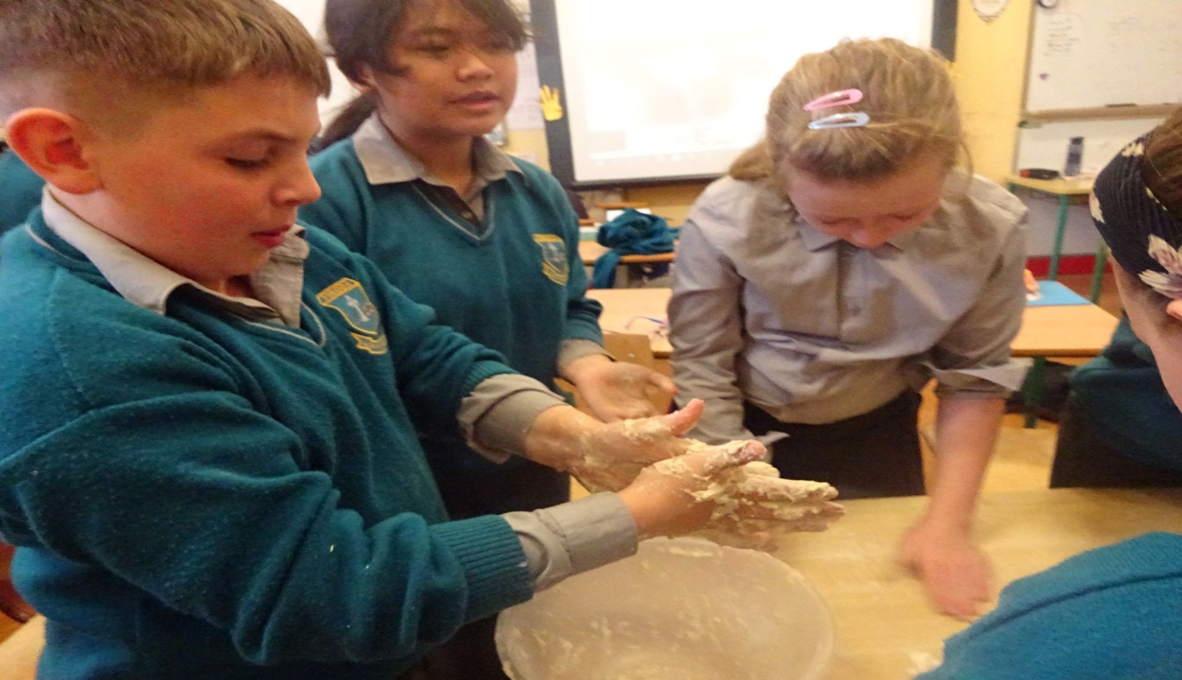
Will this dough ever come off my hands?

Slide 6
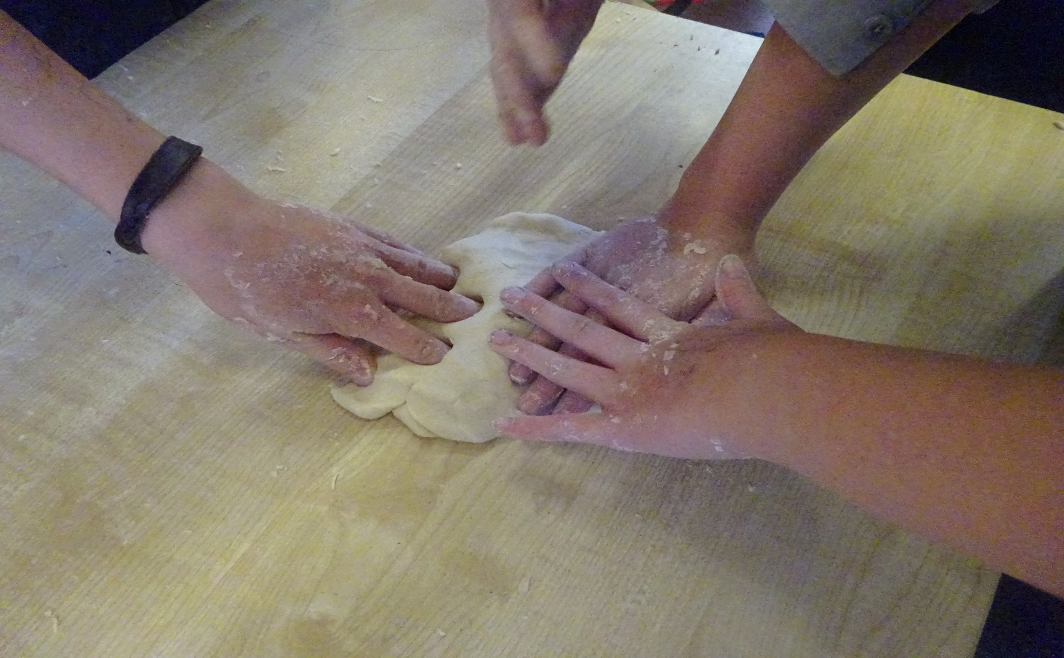
Kneading the dough

Slide 7
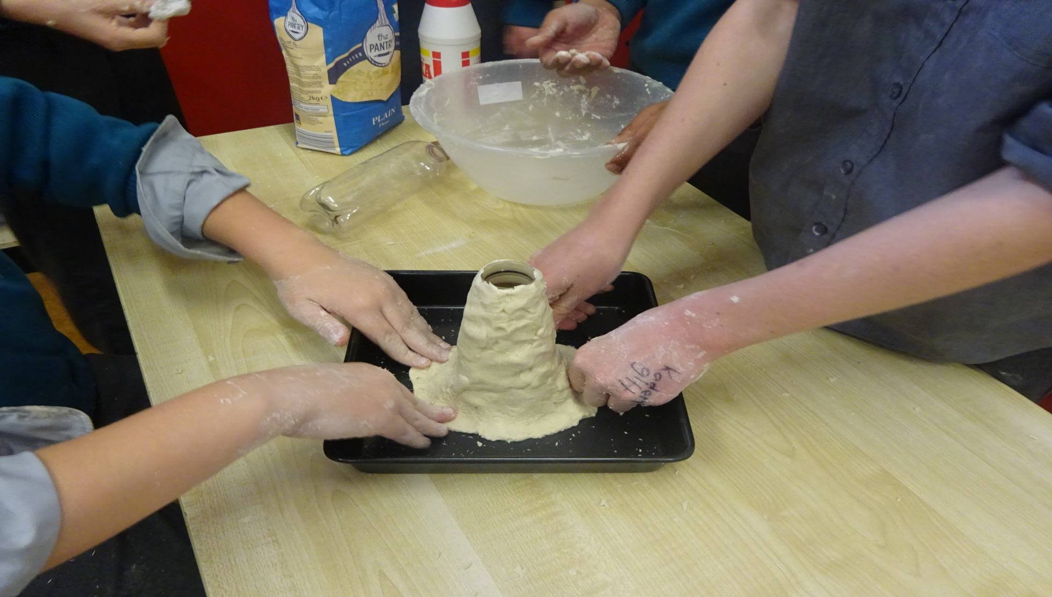
Beginning to take shape ☺

Slide 8
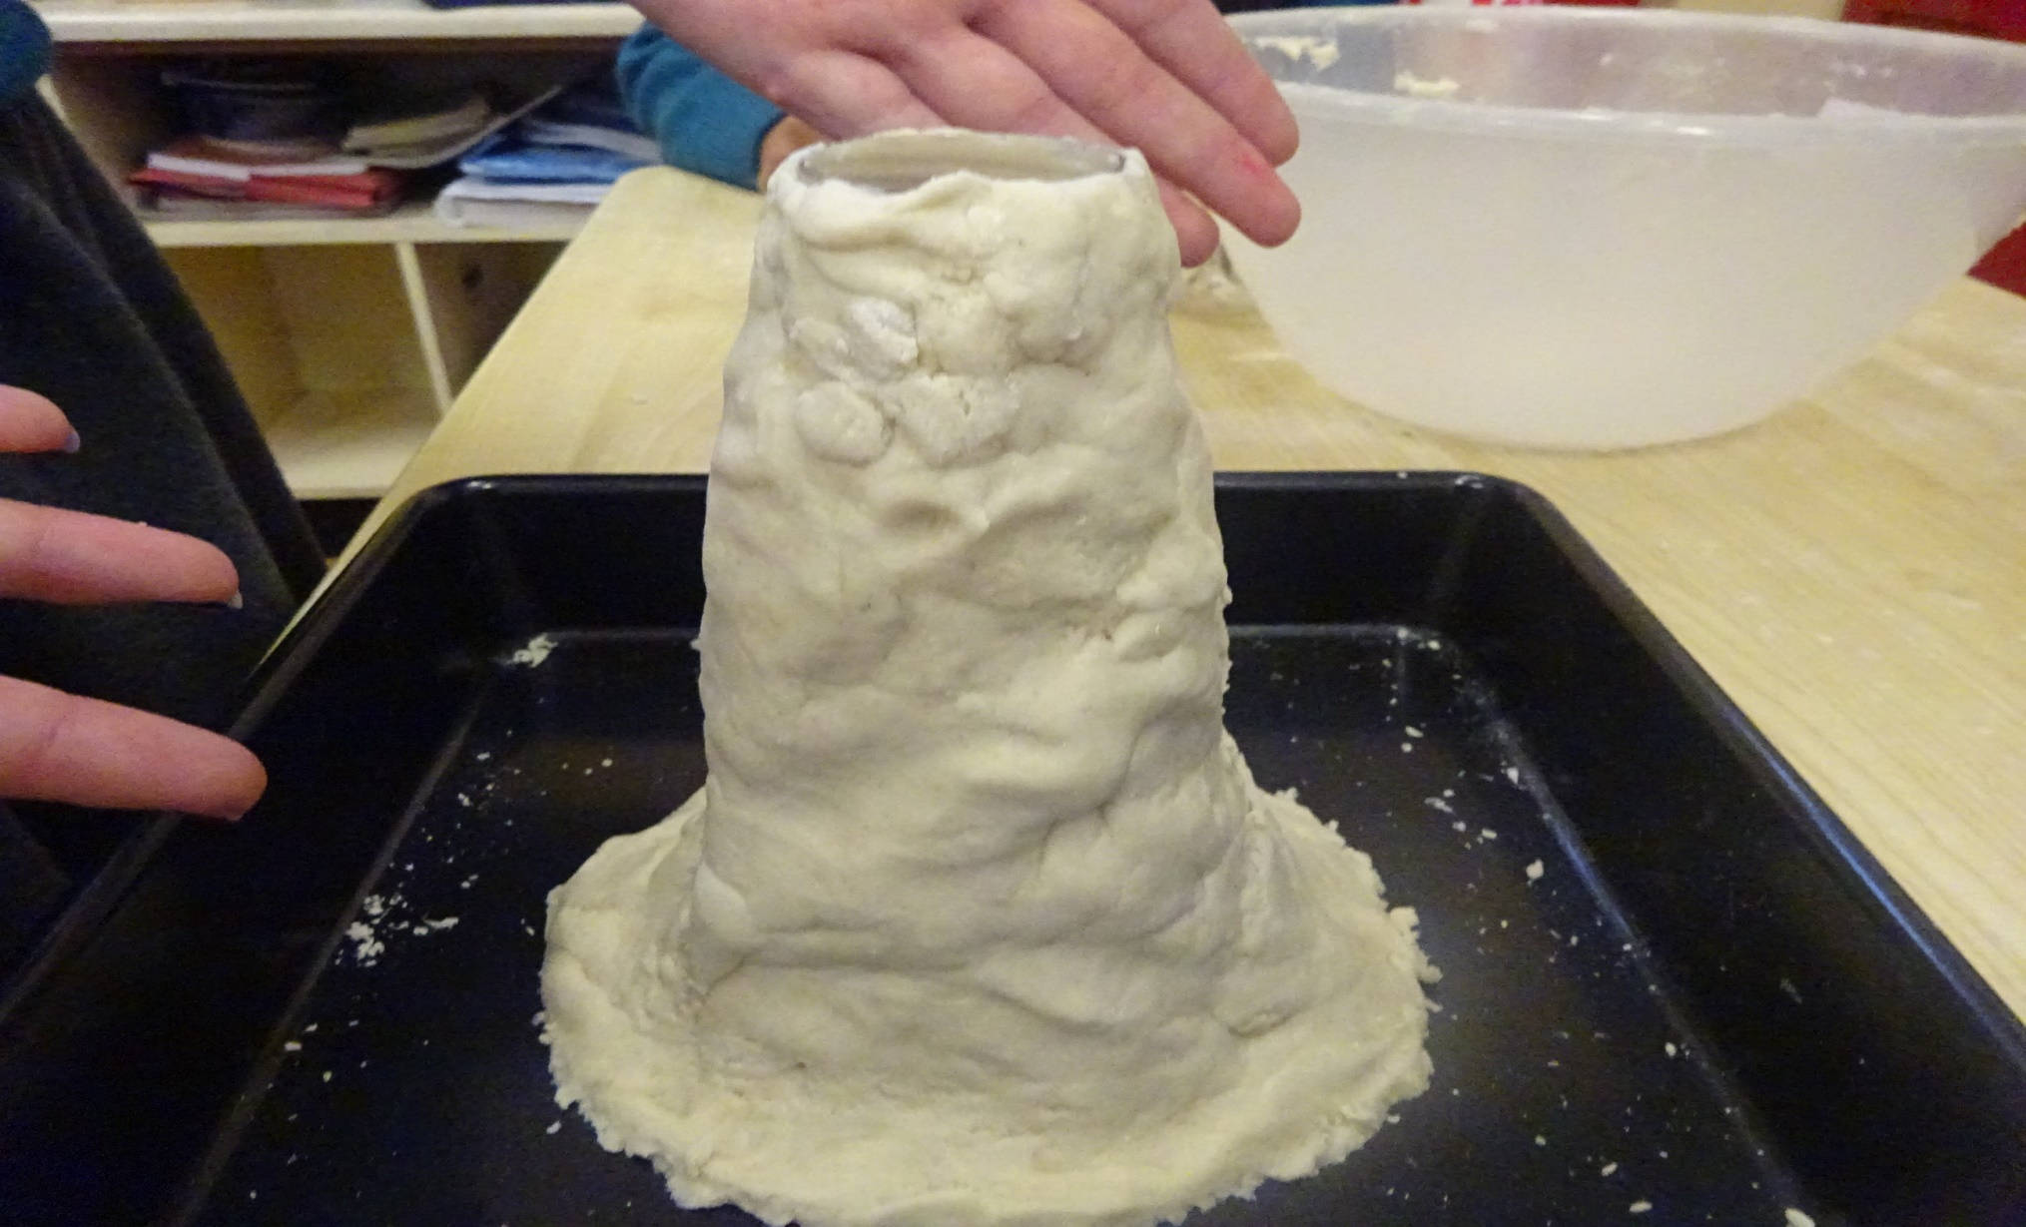
Ta- dah!

Slide 9
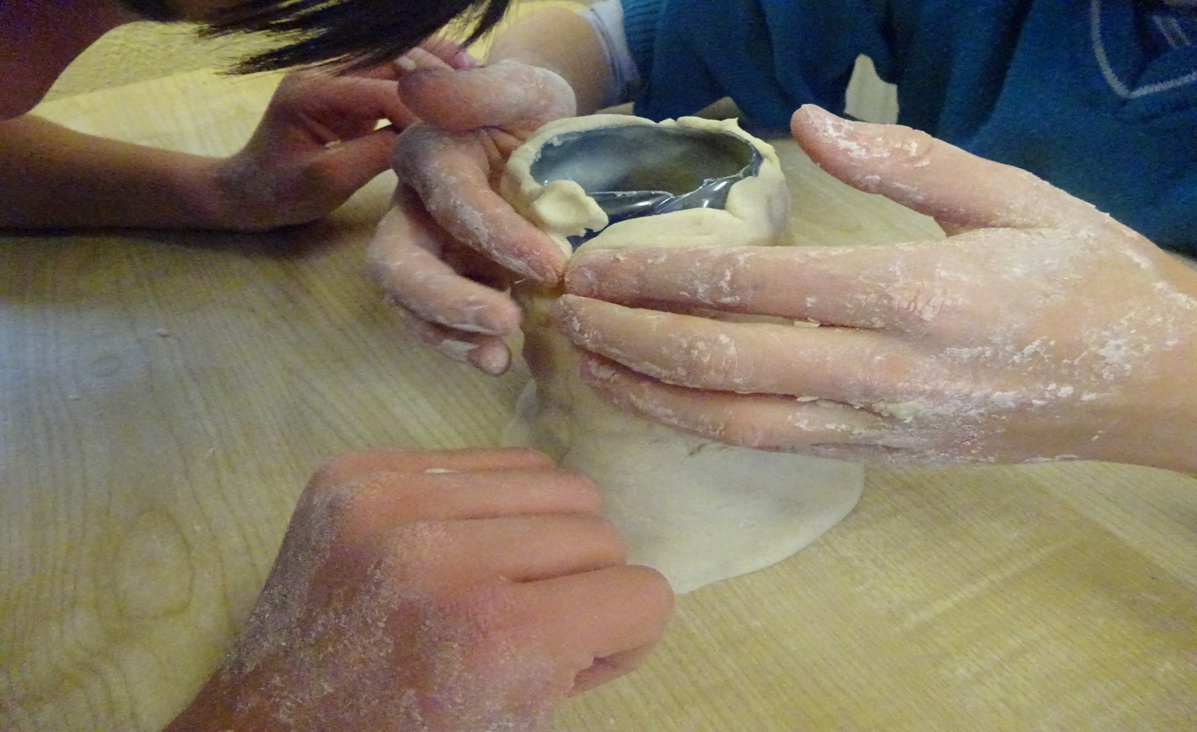
Perfecting it.

Slide 10
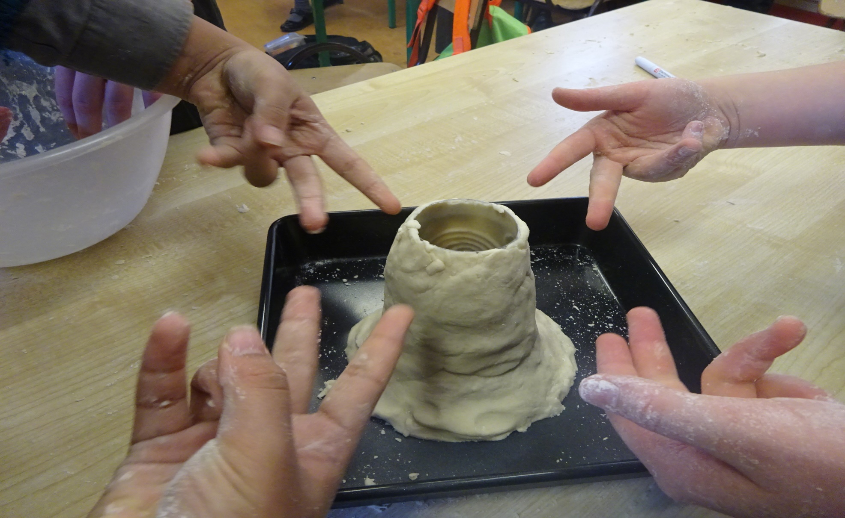
A job well done ☺

Slide 11
Thumbs up if you like ours.

